Slide 1
Hawaii Fires Assessing fires relationship with precipitation
and land use on the Big Island of Hawaii
Trace Martin & Ivette Castaneda
Notes:
Annotate your slides here. This is where you can expand information to describe what you’ve done in greater detail for us to grade. Please keep it to a max of 100 words per slide.
You can include 1-2 hidden slides that are in print out but not discussed in the talk, but DO NOT include more than that. This should only be used for additional results or additional methodological details.

Slide 2
Background
Fire is an ecological process and non managed fires can impact significantly in human lives, economic costs, biodiversity and forest loss.
Wildfire management is a prominent challenge in the environmental agenda in the U.S. that has received attention in the last decades.
In Hawaii, wildland fire now occurs frequently and extensively across the state.
Fires in Hawaii are mostly from human caused ignitions, land use legacies and change, and pronounced dry seasons and strong rain shadow effects
However, wildfire management in Hawaii has only become to be part of the environmental agenda in the last decade.
Resources | Pacific Fire Exchange

Slide 3
Project Goal
We focused our work on the Big Island of Hawaii.
The goal of this project was to understand the natural conditions where fires arise and the impacts in land use in the big island.
Specifically we :
1) Assessed the spatial distribution of fires in the 1999-2022 period across land cover.
2) Assessed the spatial distribution of precipitation and link it with fire burned areas.

Slide 4
Data
Data set | Sourced from
State of Hawaii GIS Data base Land cover at 30m resolution | https://geoportal.hawaii.gov/search?collection=Dataset.
Large Fire Perimeter Data for Hawai'i (1999 - 2022) University of Hawai'i at Mānoa. Polygons of contains polygons of wildland fire perimeters for the main Hawaiian Islands from 1999 to 2022 | https://pacificfireexchange.org/resource/
Rain gauges of Hawaii - Month-Year Rainfall Maps Vectors, points (variable years from the 1800 - 2022) | http://rainfall.geography.hawaii.edu/downloads.html

Slide 5
Conceptual Model
Hawaii Coastline
Add and calculate field
Select by Attribute
Select by Attribute
Hawaii Rain Gauges
XY Table to Point
Create Thiessen Polygons
Clip
Target Rain Gauges
Big Island Boundary
Thiessen Polygons
Clip
Wildfires
Dissolve
Polygon to Raster
Zonal Statistics
Clip
Land cover
Clip
Reclassify
Reclassified Land Cover
Clip
Intersection
Government Land
Ignitions of Fires >1 acre
Data
Select by Attribute
Select by Location
Fire Ignitions
Dissolve
Federally owned land
Tool
Dissolve
Buffer
Federal wildfire ignition
Output
DOD Parcels

Slide 6
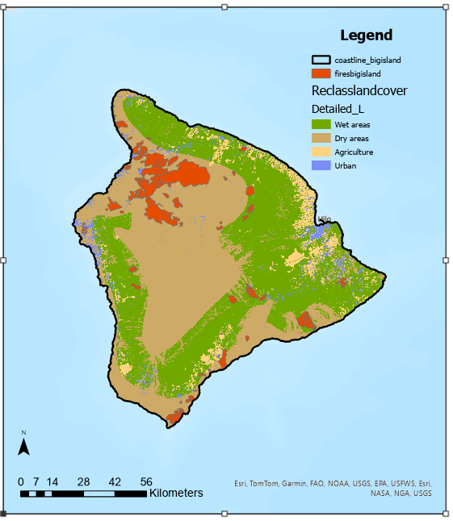
Methods
We used information on fires perimeters from 1999-2022 and land cover to describe the relationship between fires area and land use.
While land cover data was initially presented in 41 different categories, we reclassified in only 4 areas: wet / dry areas, developed areas (urban), agricultural areas.

Slide 7
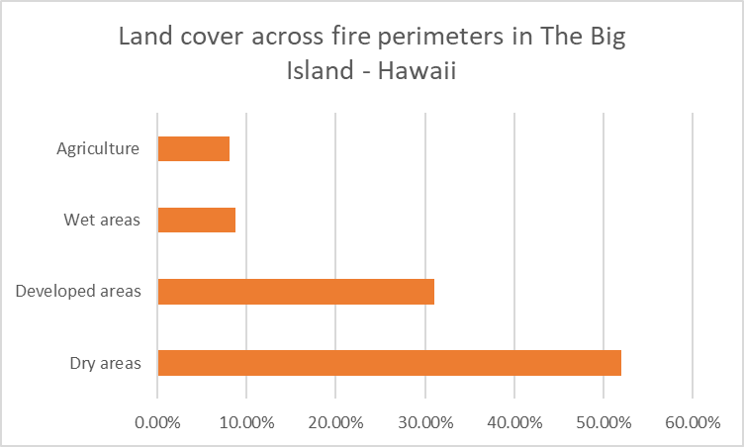
Results

Slide 8
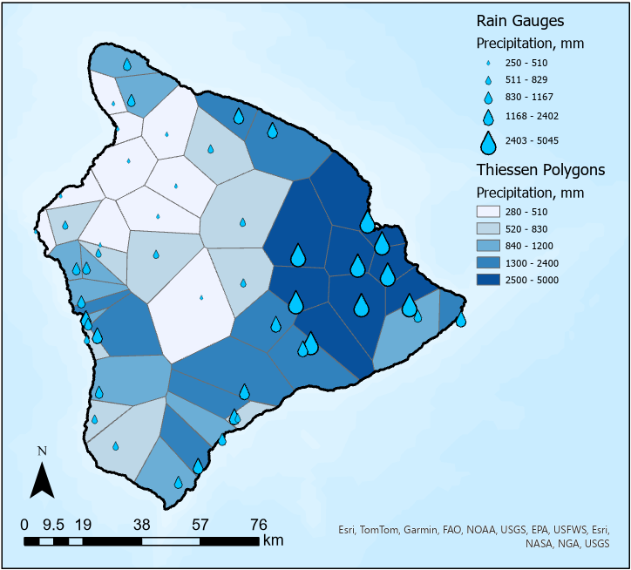
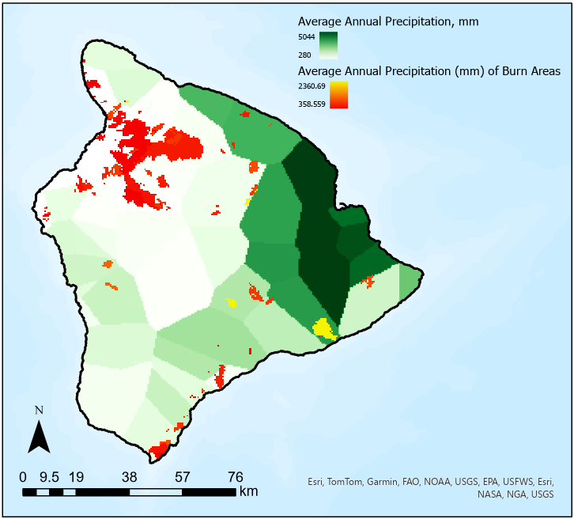
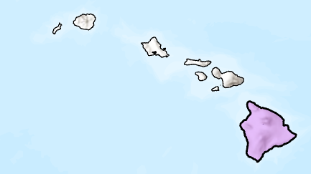
Methods
We used information on fires perimeters from 1999-2022 and long term average precipitation to account the relationship of fire burn area and climate conditions.

Slide 9
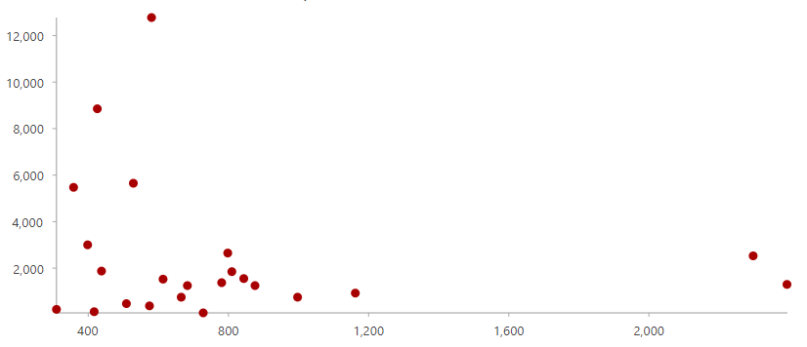
Results
Fire Size and Frequency Based on Dryness
Acres Burned
Long term average annual precipitation (mm/yr)

Slide 10
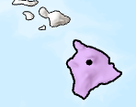
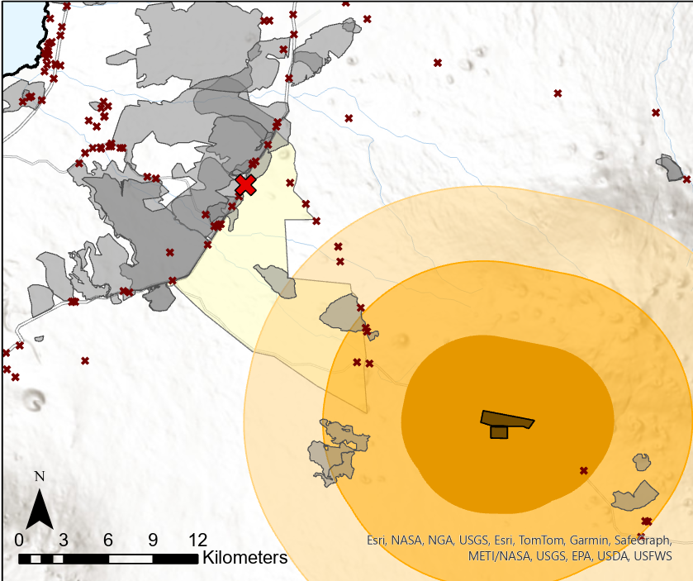
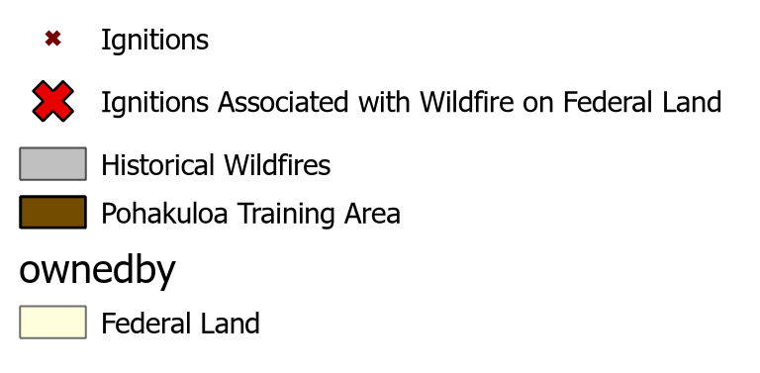
Future Work
Fires in Hawaii are mostly from human caused ignitions.
More research about the specific causes need to be done

Slide 11
Results
Fires in The Big Island of Hawaii are characterized by:
Large extents of dry non developed areas account for more than 50% of total land cover on fires in the big island.
Strong relationship with fire and pronounced dry areas, as well as low regional average precipitation

Slide 12
Conclusions
Caveats
Between 1999-2022, more fires happened in dry areas, based in the land cover and long term annual precipitation.
We believe that an interesting variable for future analysis are the human caused ignitions. If we are able to analyze where they are / were more common, we can provide assessment on relevant areas to implement preventive measures.
The dates of the precipitation data don’t exactly match those of the fires, since data was not available for all years.
The Thiessen Polygon method for calculating precipitation does not account for topography.

Slide 13
Citations
https://geoportal.hawaii.gov/search?collection=Dataset.
https://pacificfireexchange.org/resource/
http://rainfall.geography.hawaii.edu/downloads.html

